Slide 1

Boston Housing Dataset

Slide 2
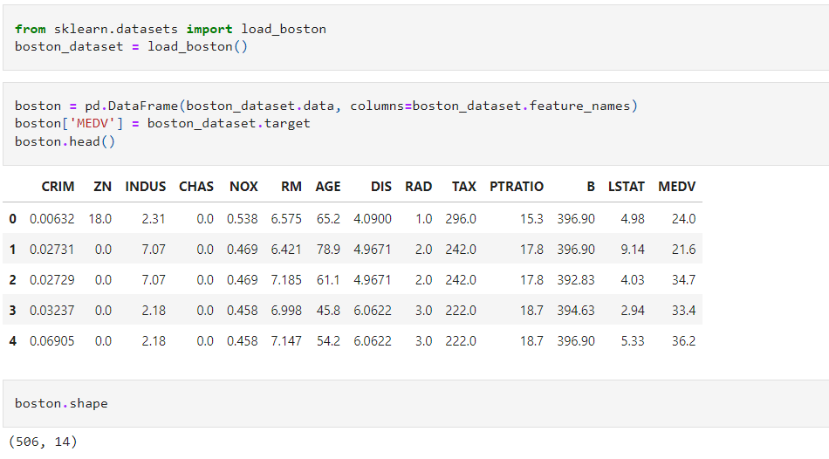
Dataset Background
Collected by U.S. Census Service for houses in the area of Boston, Massachusetts
506 data/houses, 14 variables
Response variable is MEDV, median home value.

Slide 3
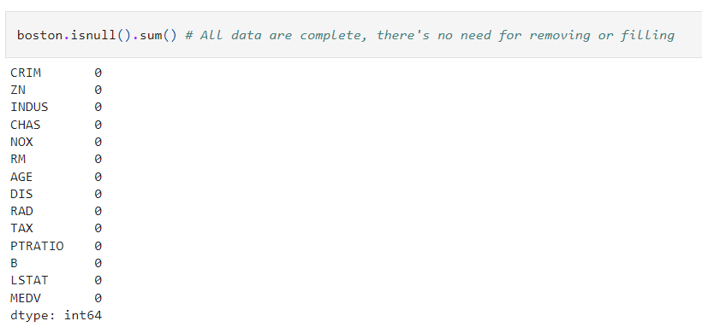
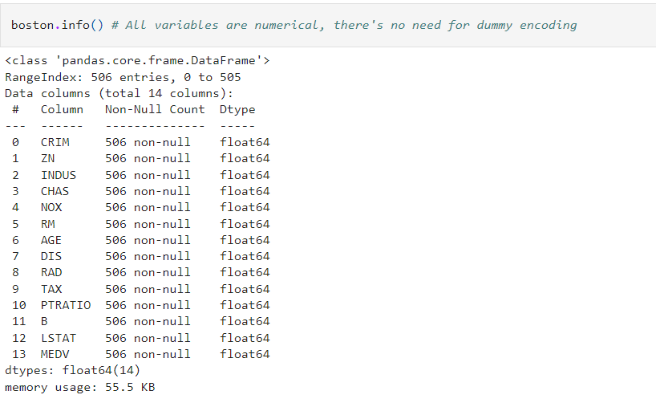
Dataset Background
No missing values
All 14 variables are numerical

Slide 4
Objectives
Linear Method to predict MEDV, comparing result from different cost function of OLS, Ridge, Lasso, and Elastic-Net Regression using L2 loss function - MSE.
Come out with the best model interpretation
Study the data distribution to challenge linearity assumption.
Suggest alternative method for improving prediction.

Slide 5
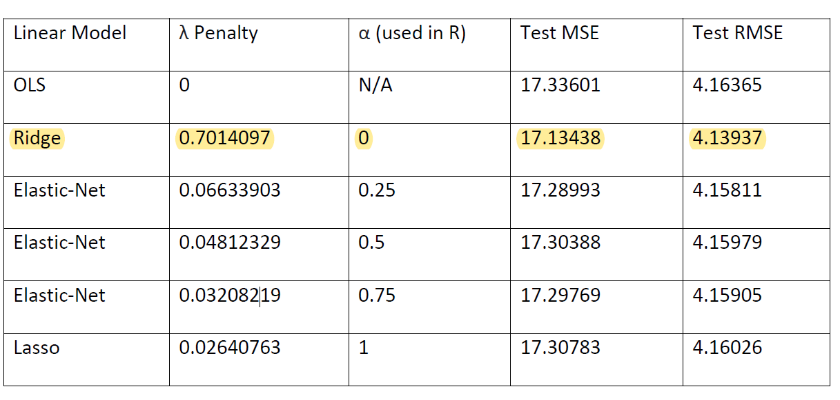
Outcome

Slide 6
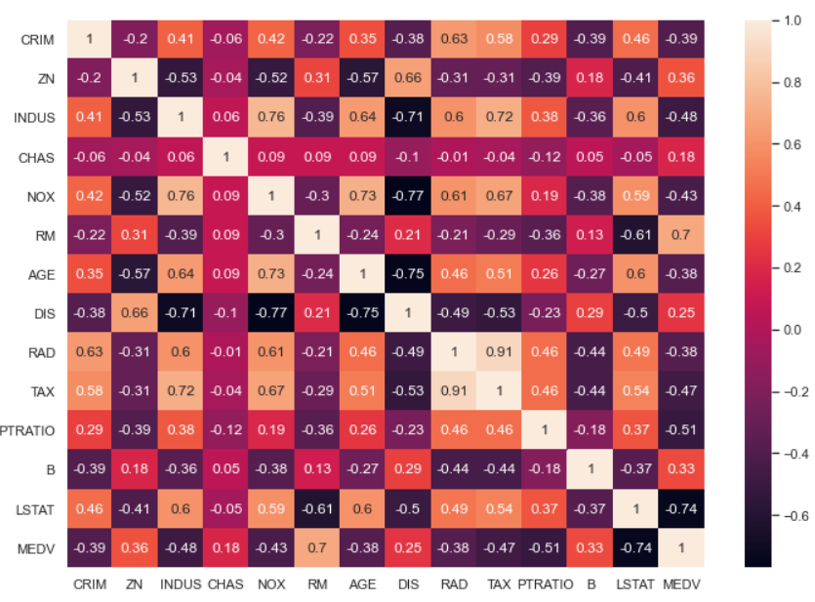
Ridge vs OLS
The data consist significant correlation
Which favor Ridge over OLS, as Ridge shrink correlated variables

Slide 7
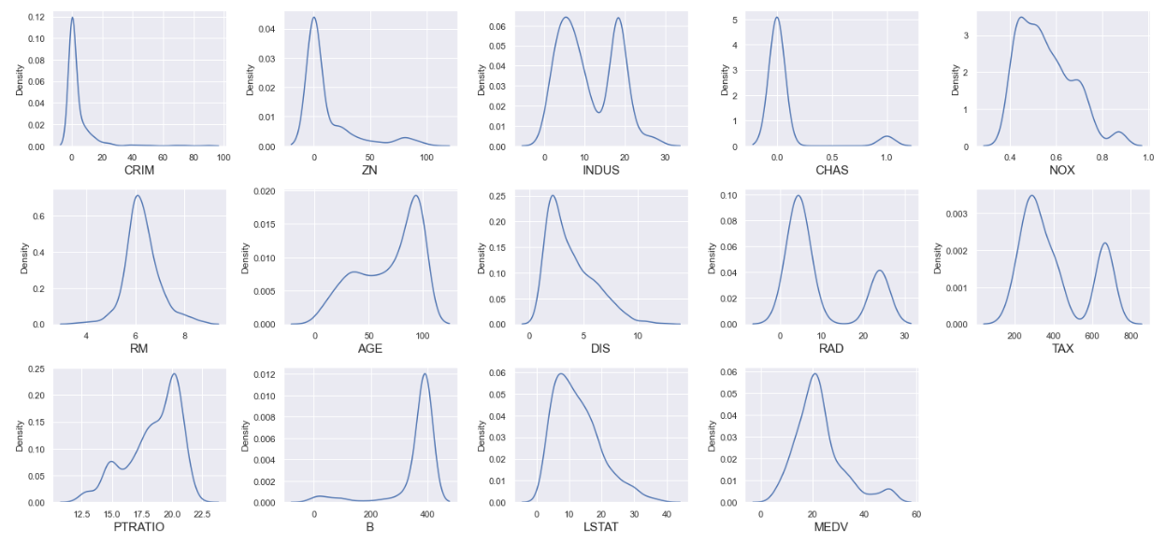
Ridge vs Lasso
Only a little sparsity, which didn’t give much advantage to Lasso over Ridge

Slide 8
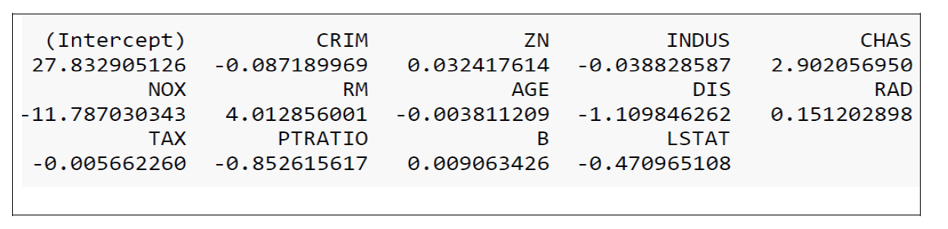
Model Selection Outcome
Ridge regression is the best linear model for Boston Housing Data
The lambda penalty parameter selected by cross-validation is 0.7014
The model coefficient built with full dataset are as follow:

Slide 9
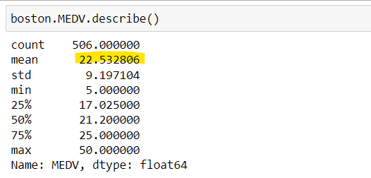
Further Comment
All linear regression models have RMSE of around 4.1, fairly high compared to 22.532, the sample mean of MEDV, roughly 20% prediction error
Could it be linear method a poor fit for this dataset?

Slide 10
Linear Model Assumption
1. Linear relationship: Linear relationship between the independent variable, x, and the dependent variable, y.
2. Independence: The residuals are independent. In particular, there is no correlation between consecutive residuals in time series data.
3. Homoscedasticity: The residuals have constant variance at every level of x.
4. Normality: The residuals of the model are normally distributed with mean 0.

Slide 11
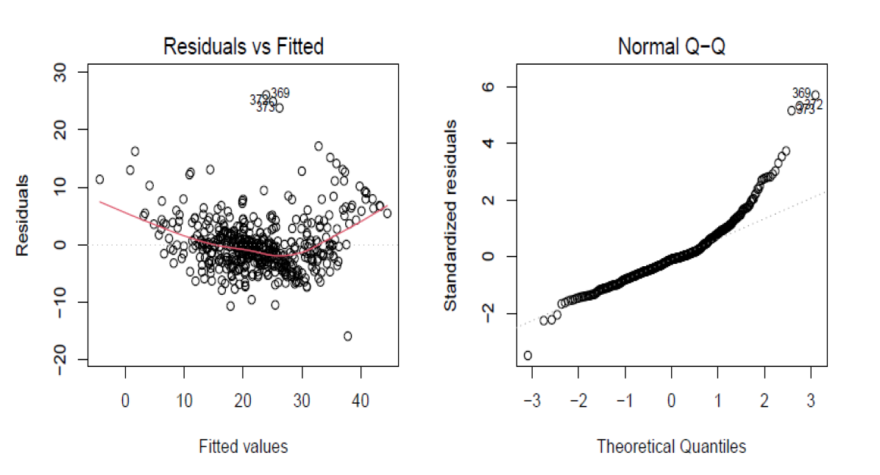
OLS Residual vs Fitted plot and Normal Q-Q
Banana shape in residuals vs fitted plot, the assumption of linear model being violated, or wrong model e.g. non-linearity
Normal Q-Q indicate non-normal of residual error.

Slide 12
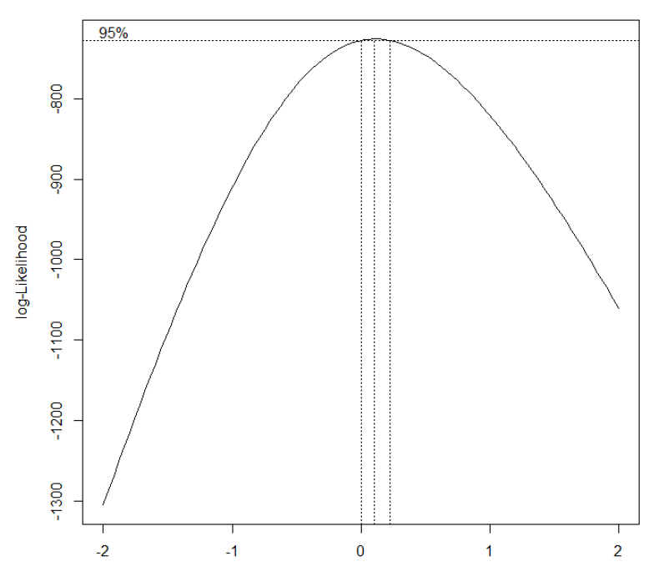
Box-Cox Transformation to make data normal
Box-Cox suggested log transformation on Y, MEDV

Slide 13
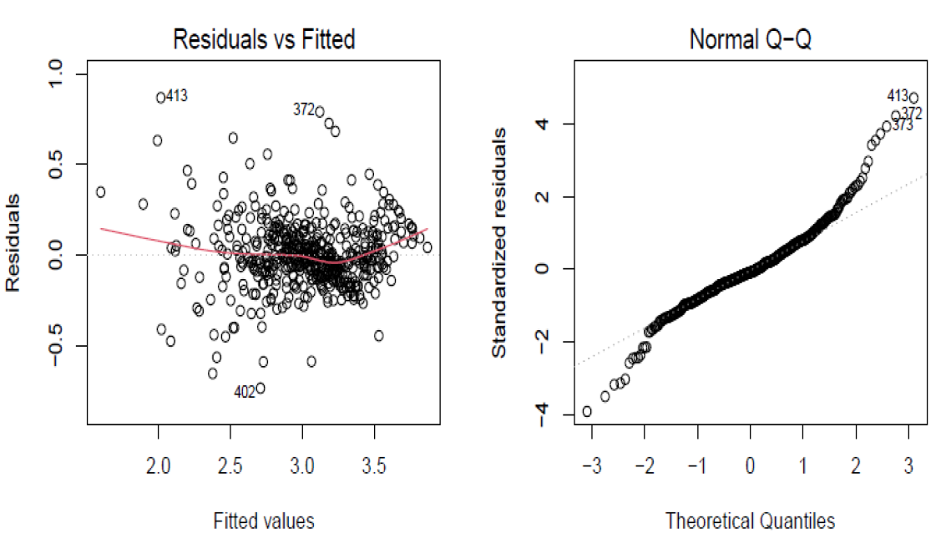
OLS with Log Transformed Response
Transformation doesn’t improved, indicated poor fit due to non-linearity

Slide 14
Conclusion and Suggestion
Ridge regression is the best linear method
The underlying data is non-linear
Can use method that deal with non-linear data:
kernel machine method like SVM
tree-based method like Decision Tree
nearest neighborhood method like KNN.
Can also try L1 loss – Mean Absolute Error (MAE) as the loss function as the data consist some outlier as observe from boxplot. As outlier inflate on L2 Loss – Mean Squared Error (MSE)

